Slide 1


Web Application to help people track and report climate change impacts
A DATABASE MANAGEMENT PROJECT

Slide 2


Presented By,
Nusrat Jahan Shawon
ID: 2130528
Lydia Chowdhury
ID: 2010144
Md Rubaiyat Al Rafi
ID: 2130242
Nizar Ahmed
ID: 2120904
Mehjabin Mazumder
ID: 2130425
Fabia Jannat
ID: 2130682
Yasin Arafat
ID: 2130315

Slide 3


Introduction
Our web application serves as a comprehensive weather information hub, providing users with real-time updates on crucial meteorological data. Users can easily access detailed temperature reports, stay informed about precipitation with rain reports, and plan ahead with a user-friendly weekly forecast feature. The design prioritizes user convenience, ensuring a seamless experience in staying abreast of current and upcoming weather conditions.

Slide 4
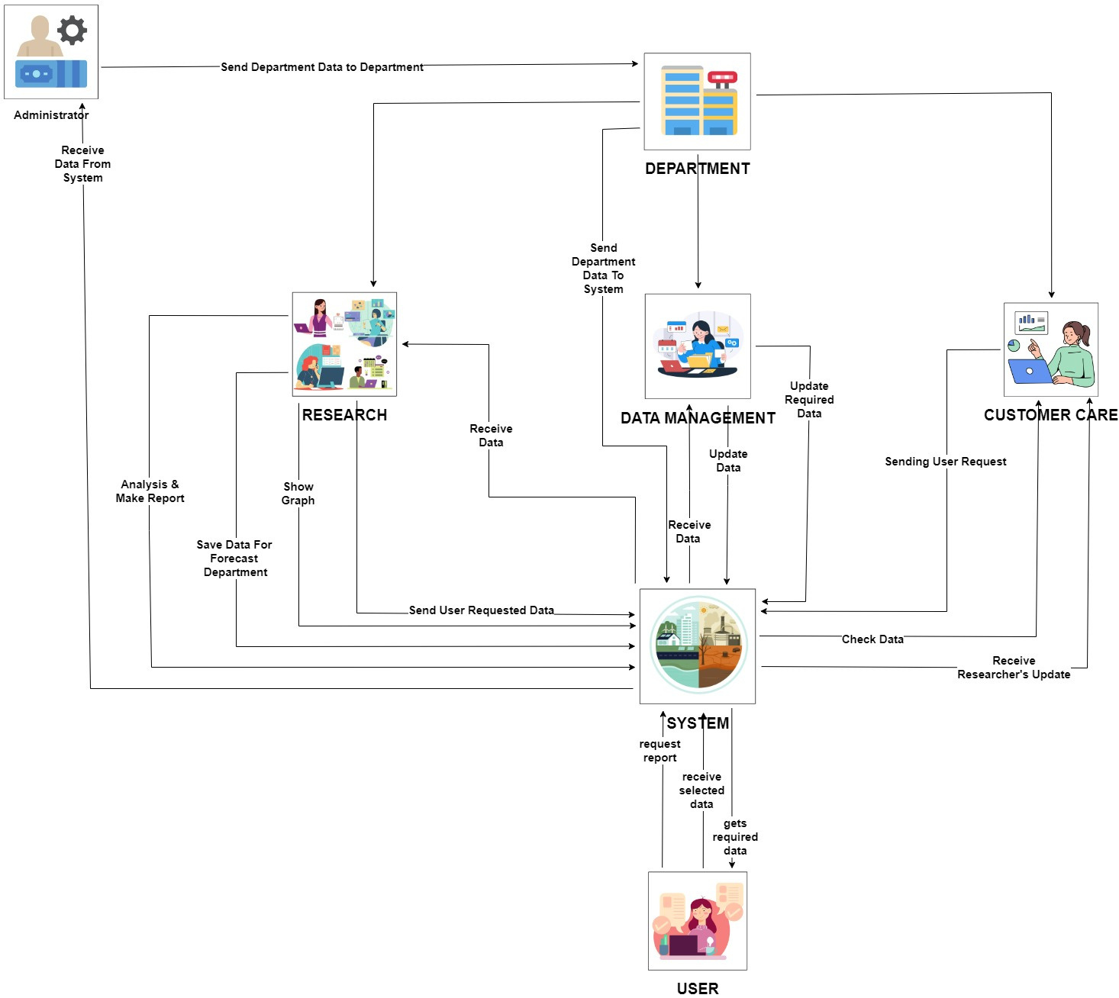
As-is rich picture
The As-in rich picture visualize the components , relationship and connection our database system.
Role highlight
System
Sends data, receive report and data from user
Research
Receive , shows graph, makes reports and save data from department and system
Data management
Receive, updates, sends data
Customer care
Receives update , sends user request
Administrator
receives data , sends data to department
User
Request report and receives data

Slide 5
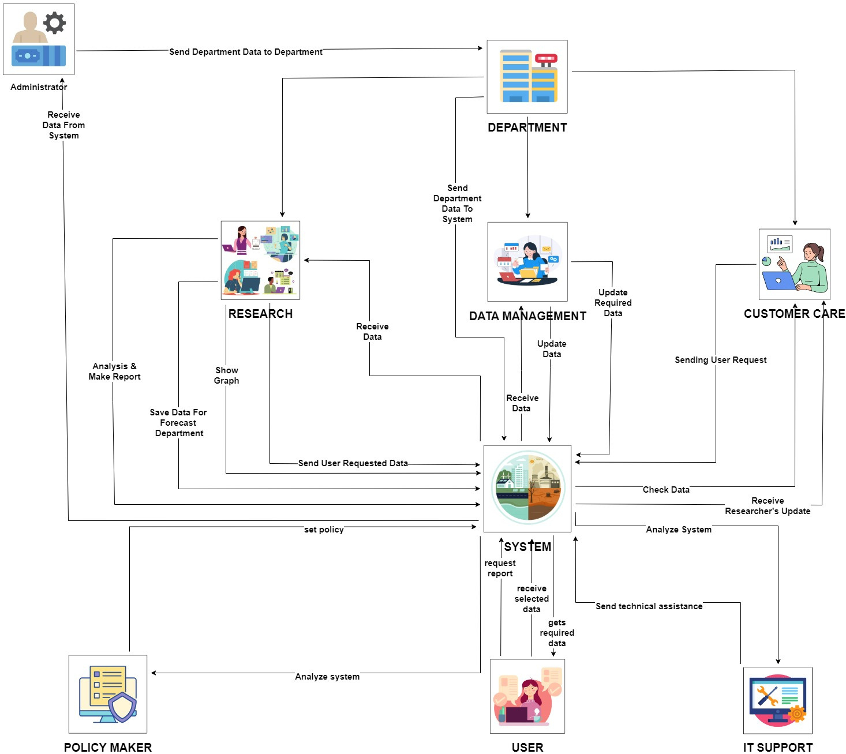
To-be rich picture
The to-be rich picture indicated our future modification that we are aiming.
It's the addition of two new entities -
Policy Maker
IT Support

Slide 6
ERD
ERD Purpose:
A visual representation of the database structure.
Illustrates relationships between different entities.
Entity: List of entities in the database.
-Department, Employee, Administrator, General User, Data_management_dept , Research_dept, Customer_care_dept, Rain_data, Tempertaure_data Researched_data , Requested_data .
Attributes: Highlights the characteristics of entity. List of attributes in the erd.
-departmentID, employeeID, adminID, userID, temperatureID, rainID, researched_data_id, requested_data_id
Relationship:One-to-one, one-to-many/many-to-one , many-many .

Slide 7
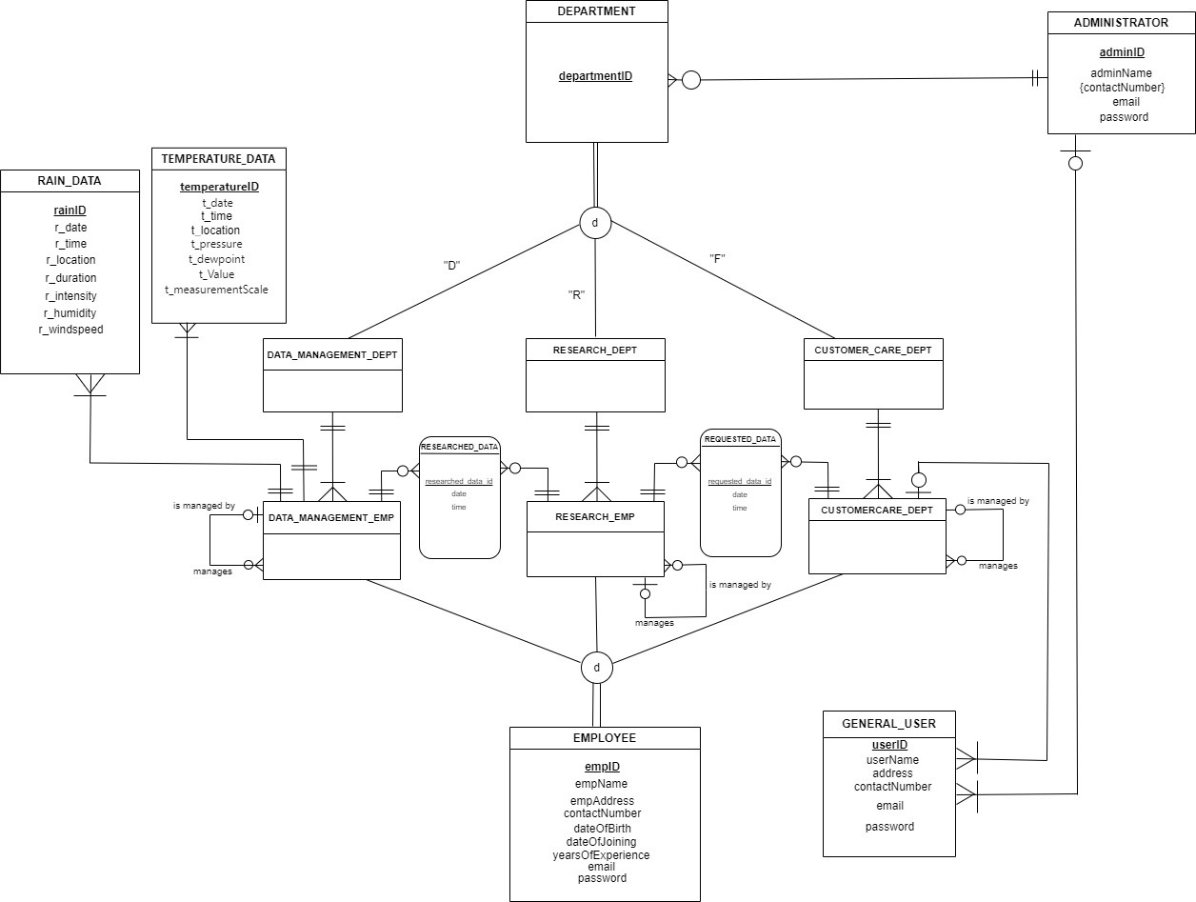
ERD

Slide 8
Relational Schema
A database schema represents the logical structure of a database. It outlines how data is organized and the relationships between different entities.
Components:
Table: Each table corresponds to an entity. In our schema the tables are- Administrator, Administrator_contact, user, Employee etc.
Column: Fields within tables. (employee_id, administrator_ID, user_id etc as shown in the diagram )
Primary key: Unique identifier for each record in the included table.
Foreign key: Links a column in one table to the primary key in another.

Slide 9
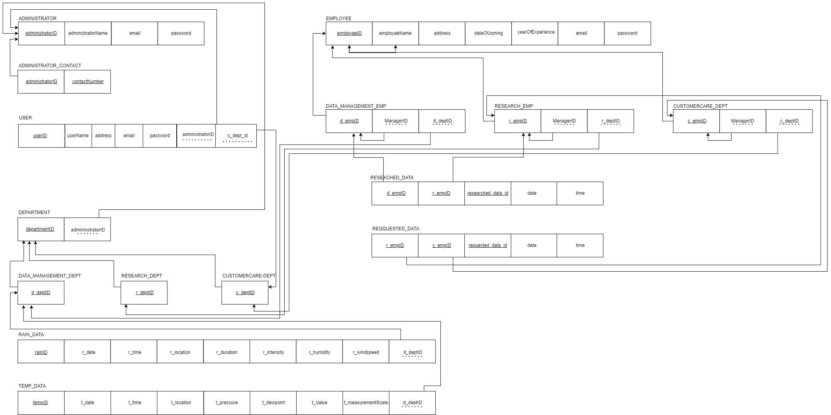
Relational Schema

Slide 10
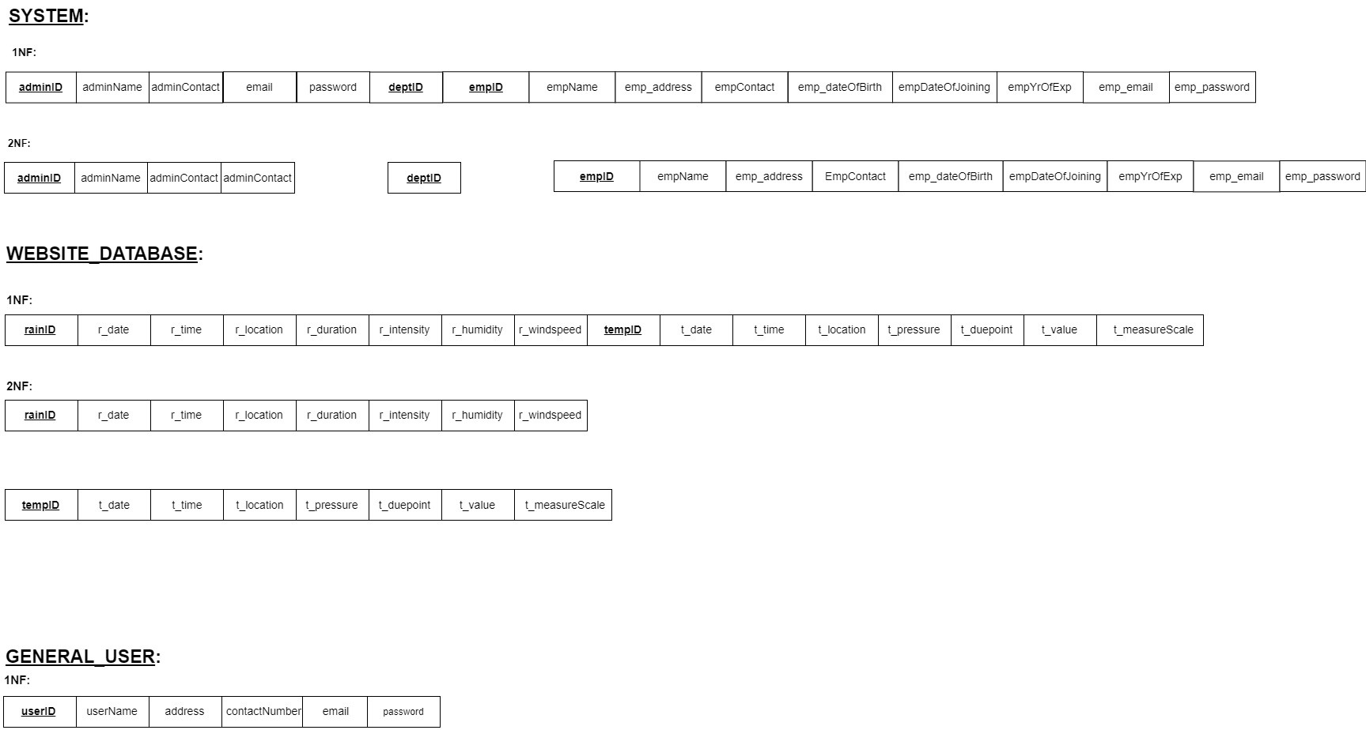
Normalization
Normalization is the process of organizing data to minimize redundancy and dependency. The normalization that we used —
1st Normal Form (1NF):
Ensures atomicity of data (no repeating groups).
2nd Normal Form (2NF):
Eliminates partial dependencies. All non-key attributes are fully functionally dependent on primary key

Slide 11
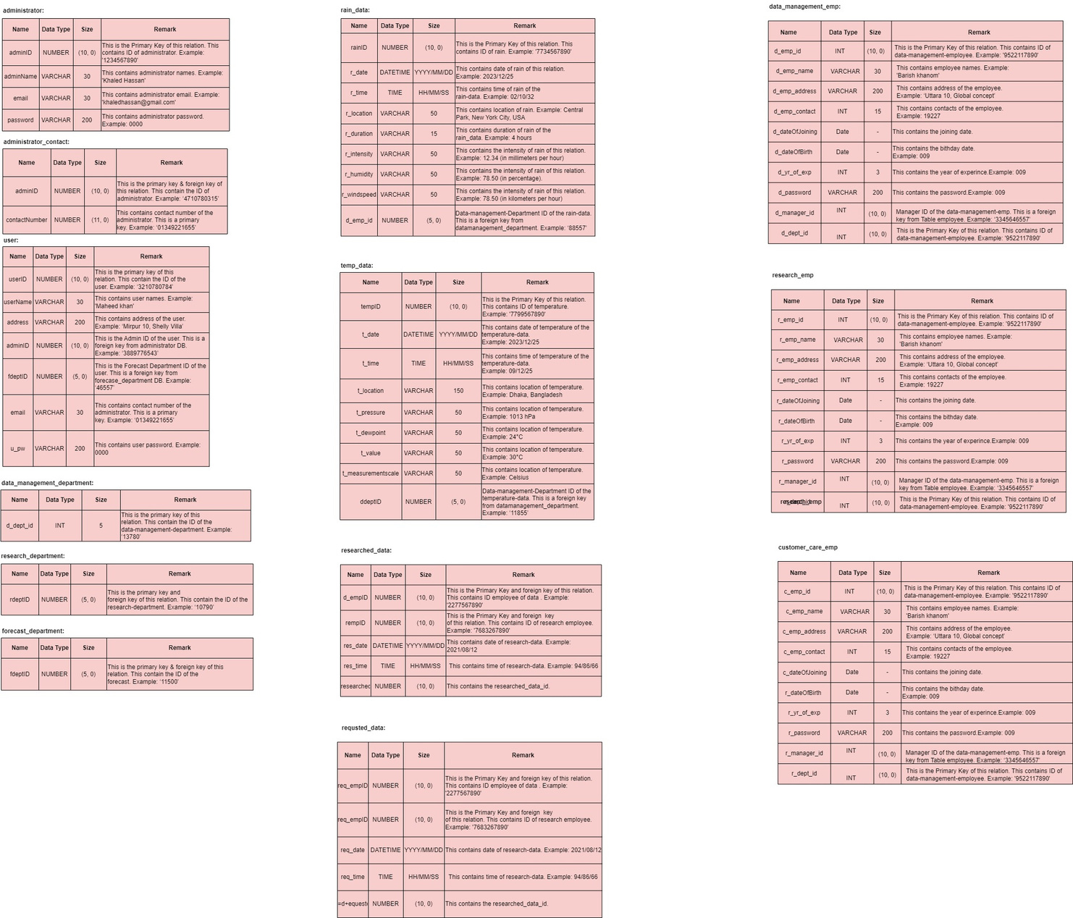
Data Dictionary
The data dictionary consists of record types (tables) created in the database by systems generated command files. Our record table consists of name, datatype, size and remarks attribute.
Department
administrator, administrator _ contact, user, research department, Forecast department
Data
rain_data , temp_data ,researched_data , requested_data
Employee
data_management_emp, research_emp, customer_care_emp

Slide 12
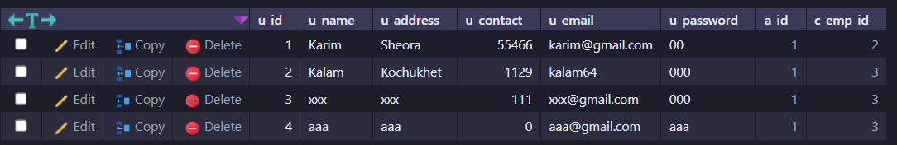

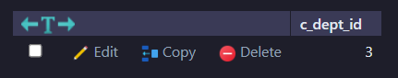

Slide 13
Conclusion
In conclusion, our web application stands as an indispensable tool for users seeking up-to-the-minute weather insights. By seamlessly delivering temperature reports, rain updates, and a convenient weekly forecast. The user-centric design ensures a smooth and efficient experience, reaffirming our commitment to keeping users well-informed about the dynamic world of weather conditions. And we hope to modify our system based on the convenience of users.

Slide 14
Thank You

